Slide 1

Digital Image Processing
Chapter9: Morphological Operations
Dr. Mohammad Javad Parseh
Jahrom University
Department of Computer Engineering and Information Technology
October 2024

Slide 2
Introduction
An important part of image analysis involves understanding the shape of the objects in that image through morphological operations.
Morphology means form or structure.
In morphological operations, the goal is to transform the structure or form of the objects using a structuring element. These operations change the shape and size of the objects in the image.
Morphological operations can be applied on binary, grayscale, and color images.
We begin with basic morphological operations such as dilation, erosion, opening, and closing and then progress to compound operations such as hit-or-miss and skeletonization.

Slide 3
Dilation
For this section, we will assume that there is a binary input image.
The foreground pixels have a value of 1 while the background pixels have a value of 0.
The dilation operation allows the foreground pixels in an image to grow or expand.
This operation will also fill small holes in an object. It is also used to combine objects that are close enough to each other but are not connected.
The dilation of the image I with a structuring element S is denoted as I ⊕ S.

Slide 4
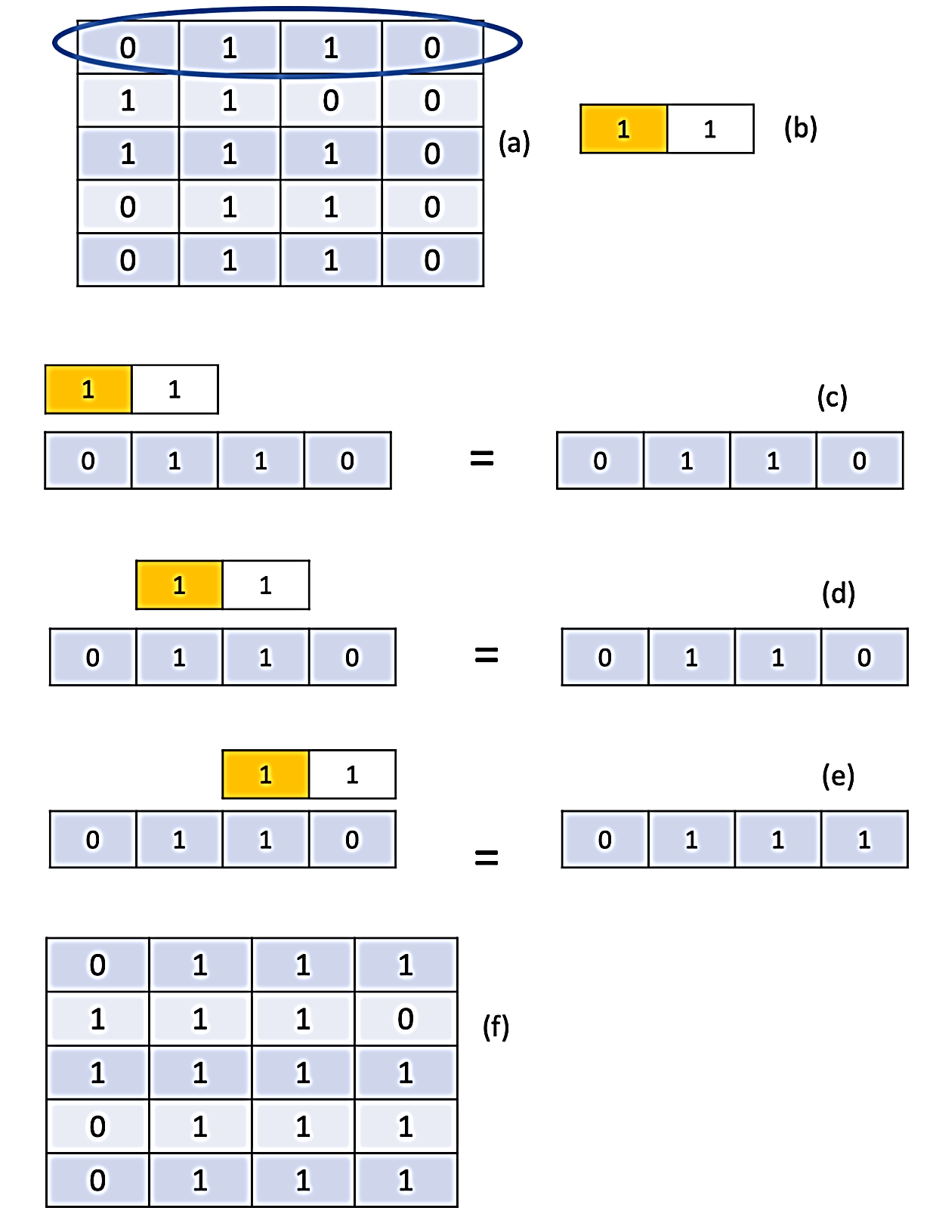
Dilation (cont.)
Reference Value
0
1
0
1
0
0
1
0
1
0

Slide 5
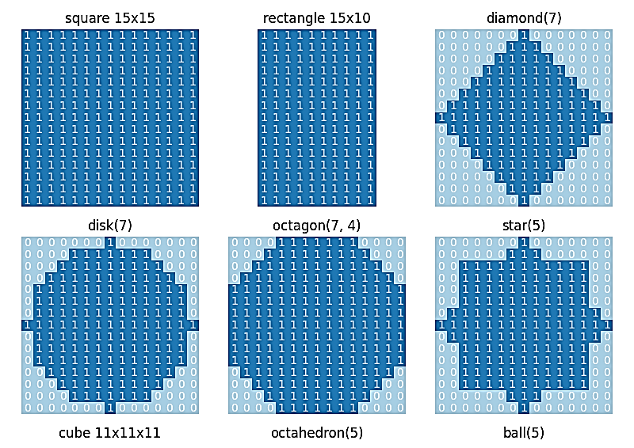
Dilation (cont.)

Slide 6
Dilation (cont.)
The dilation process first detects the boundary pixels of the object and it grows the boundary by a certain number of pixels (1 pixel to the left in this case).
By repeating this process through multiple iterations or by using a large structuring element, the boundary pixels can grow by several pixels.

Slide 7
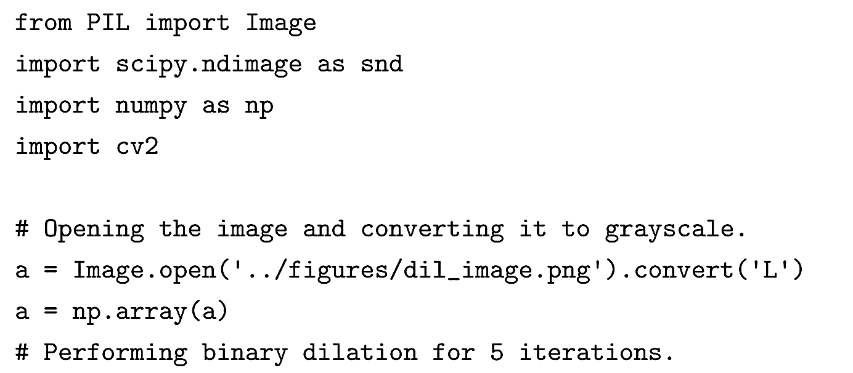
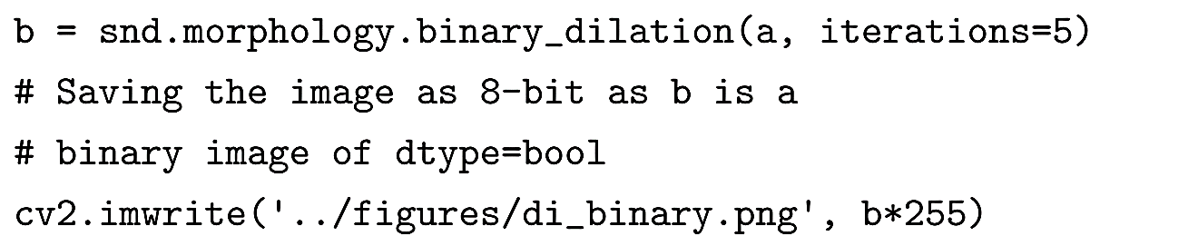
Dilation (cont.)

Slide 8
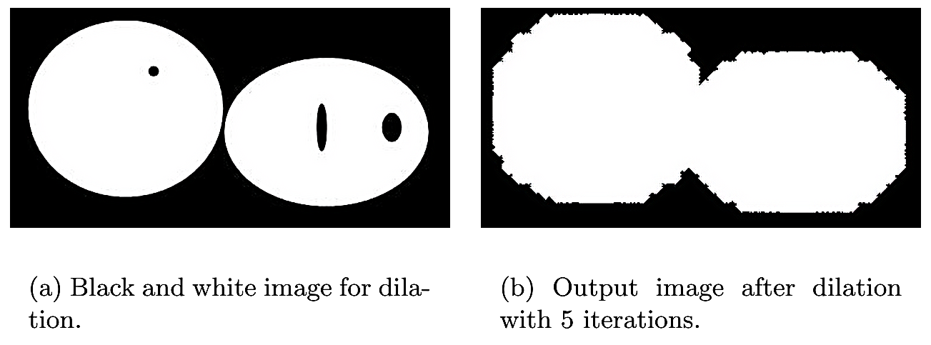
Dilation (cont.)

Slide 9
Erosion
Erosion is used to shrink objects in an image by removing pixels from the boundary of that object.
Erosion is opposite of dilation.
The erosion of the image I and with a structuring element S is denoted as I ⊖ S.

Slide 10
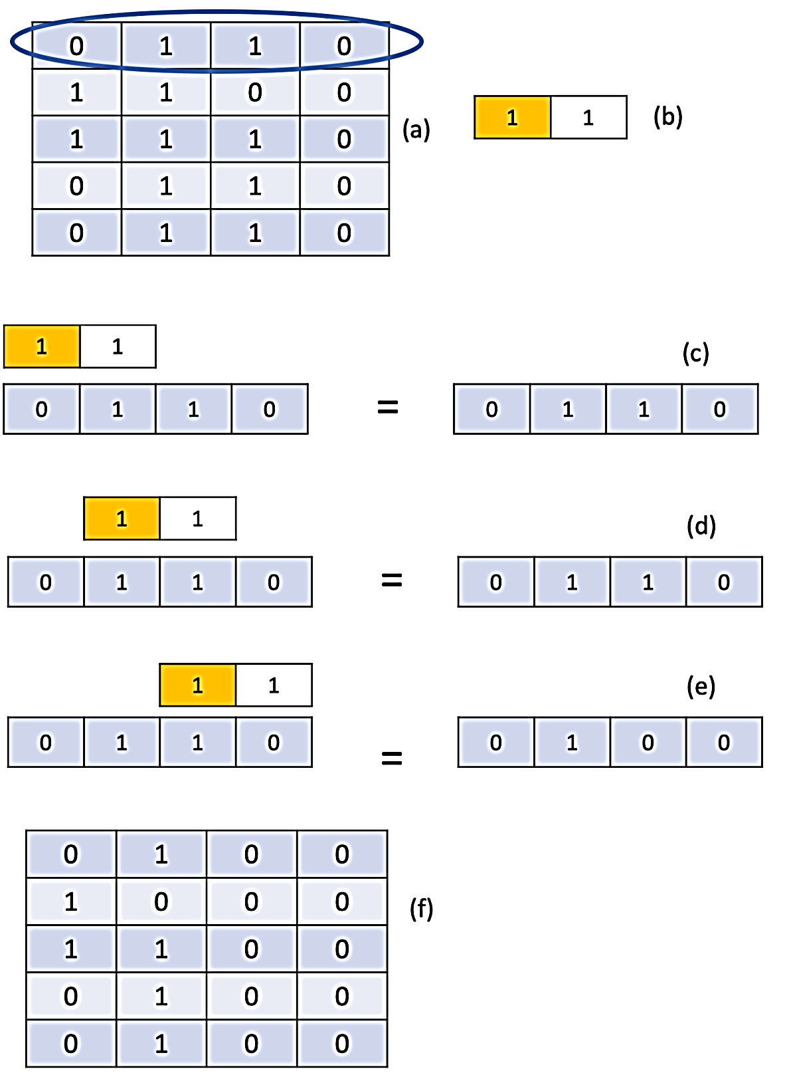
Erosion (cont.)
Reference Value

Slide 11
Erosion (cont.)
In summary, the erosion process first detects the boundary pixels of the object and shrinks the boundary by a certain number of pixels (1 pixel from the right in this case).
By repeating this process through multiple iterations or by using a larger structuring element, the boundary pixels can be shrunk by several pixels.

Slide 12
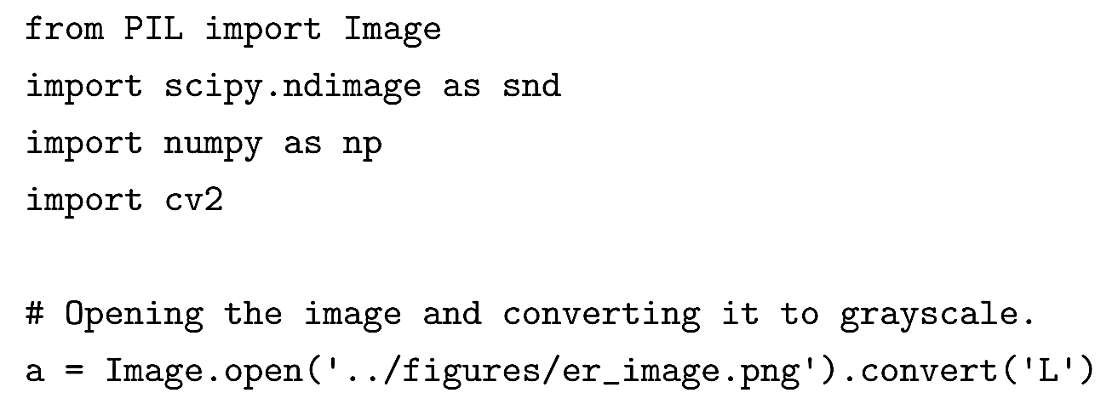
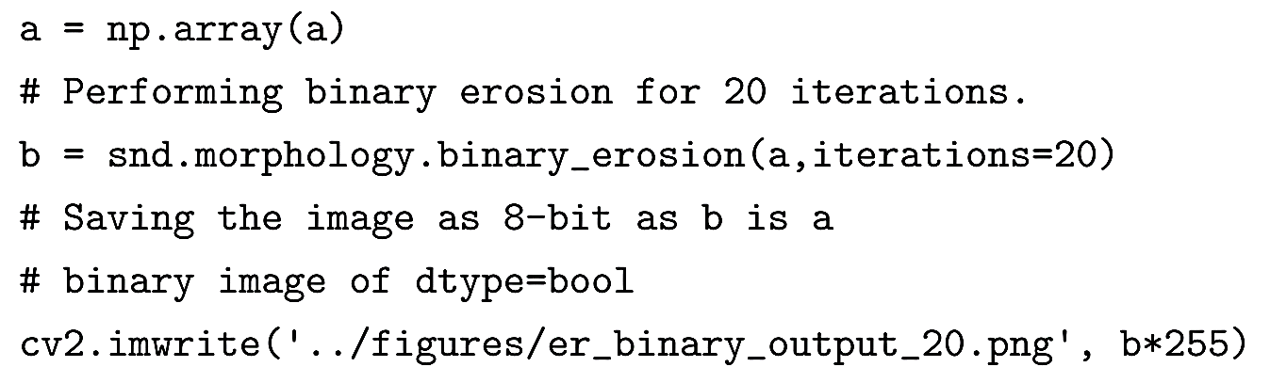
Erosion (cont.)

Slide 13
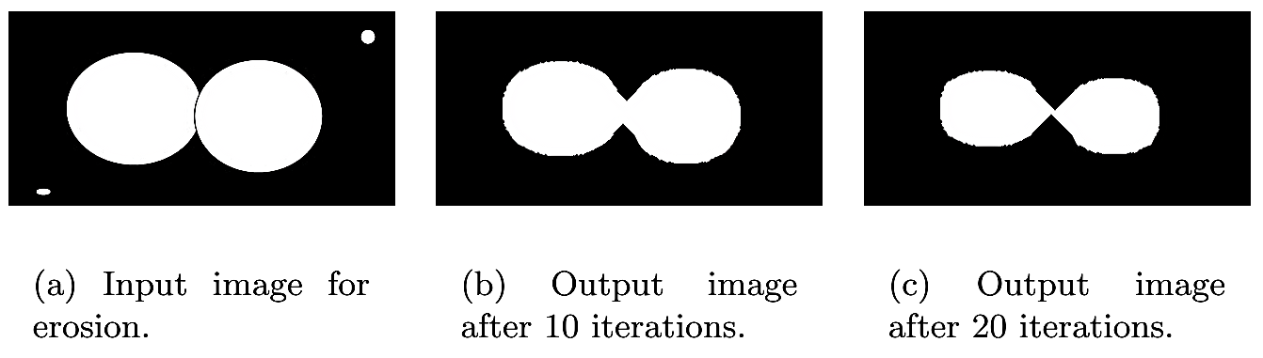
Erosion (cont.)

Slide 14
Grayscale Dilation and Erosion
Grayscale dilation and erosion are similar to their binary counterparts.
In grayscale erosion, the bright pixel values will shrink and the dark pixels increase or grow.
Small bright objects will be eliminated by grayscale erosion and dark objects will grow.
In grayscale dilation, bright pixels increase or grow and dark pixels decrease or shrink.
Similar to binary dilation, grayscale dilation fills holes.

Slide 15
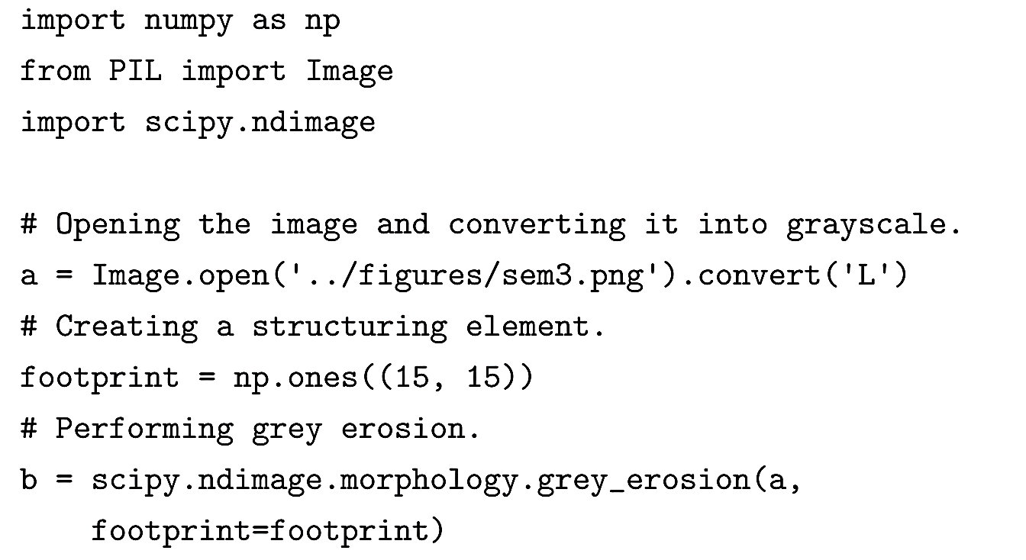
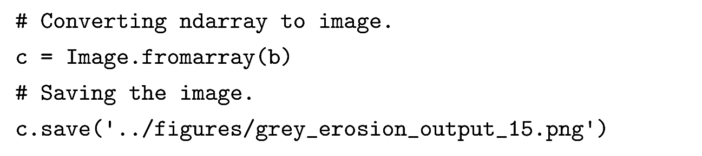
Grayscale Dilation and Erosion (cont.)

Slide 16
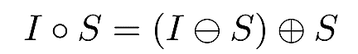

Opening and Closing
Opening and closing operations are complex morphological operations. They are obtained by combining dilation and erosion.
Opening is defined as erosion followed by dilation of an image. The opening of the image I with a structuring element S is denoted as:
Closing is defined as dilation followed by erosion of an image. The closing of the image I with a structuring element S is denoted as:

Slide 17
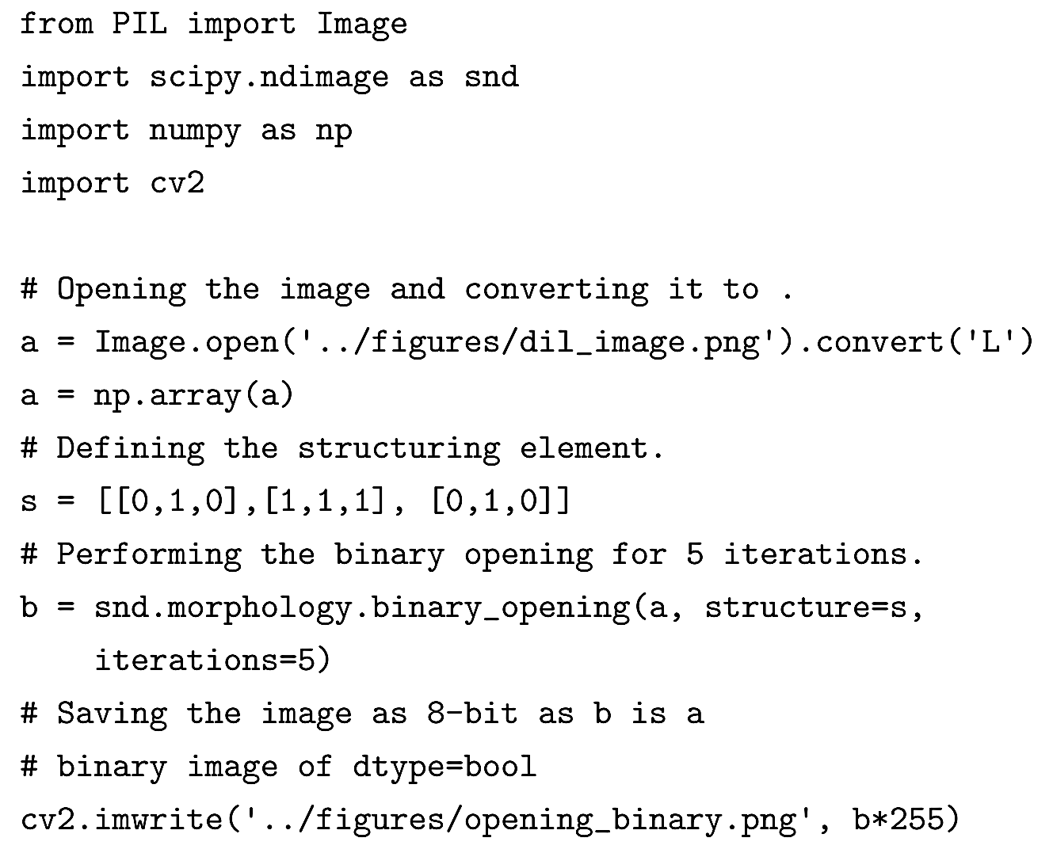
Opening and Closing (cont.)

Slide 18
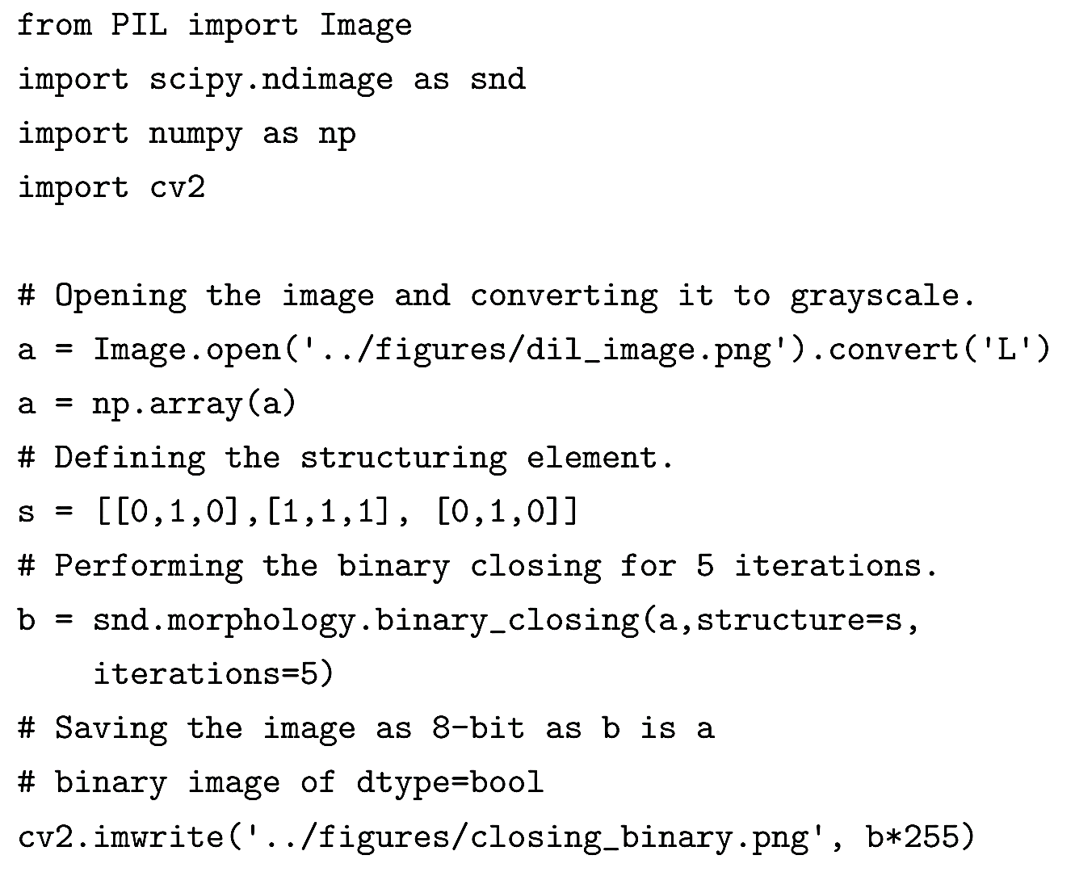
Opening and Closing (cont.)

Slide 19
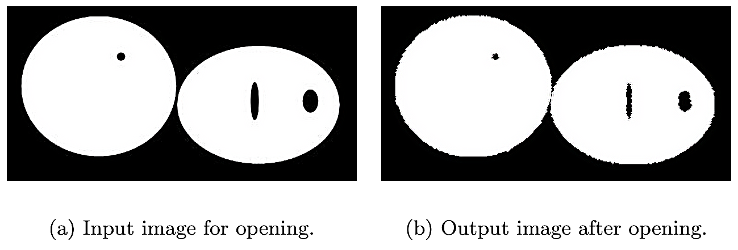
Opening and Closing (cont.)

Slide 20
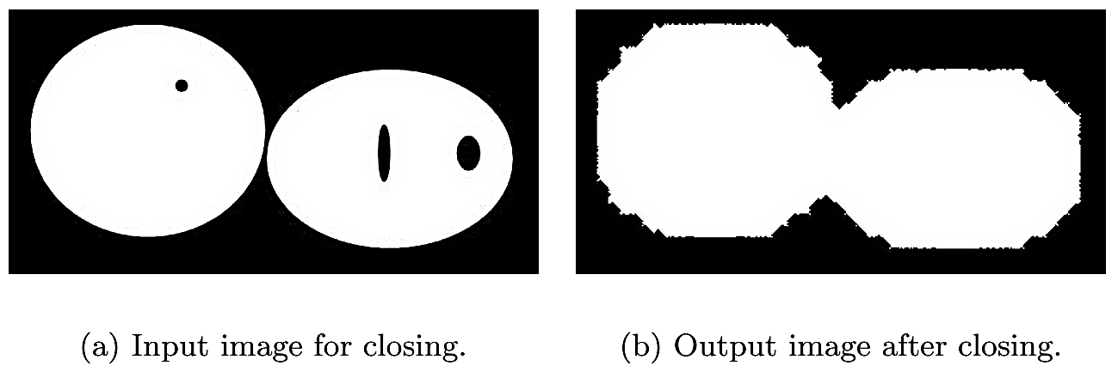
Opening and Closing (cont.)

Slide 21
Grayscale Opening and Closing
Grayscale opening and closing are similar to their binary counterparts.
Erosion followed by dilation results in opening.
Dilation followed by erosion results in closing.

Slide 22
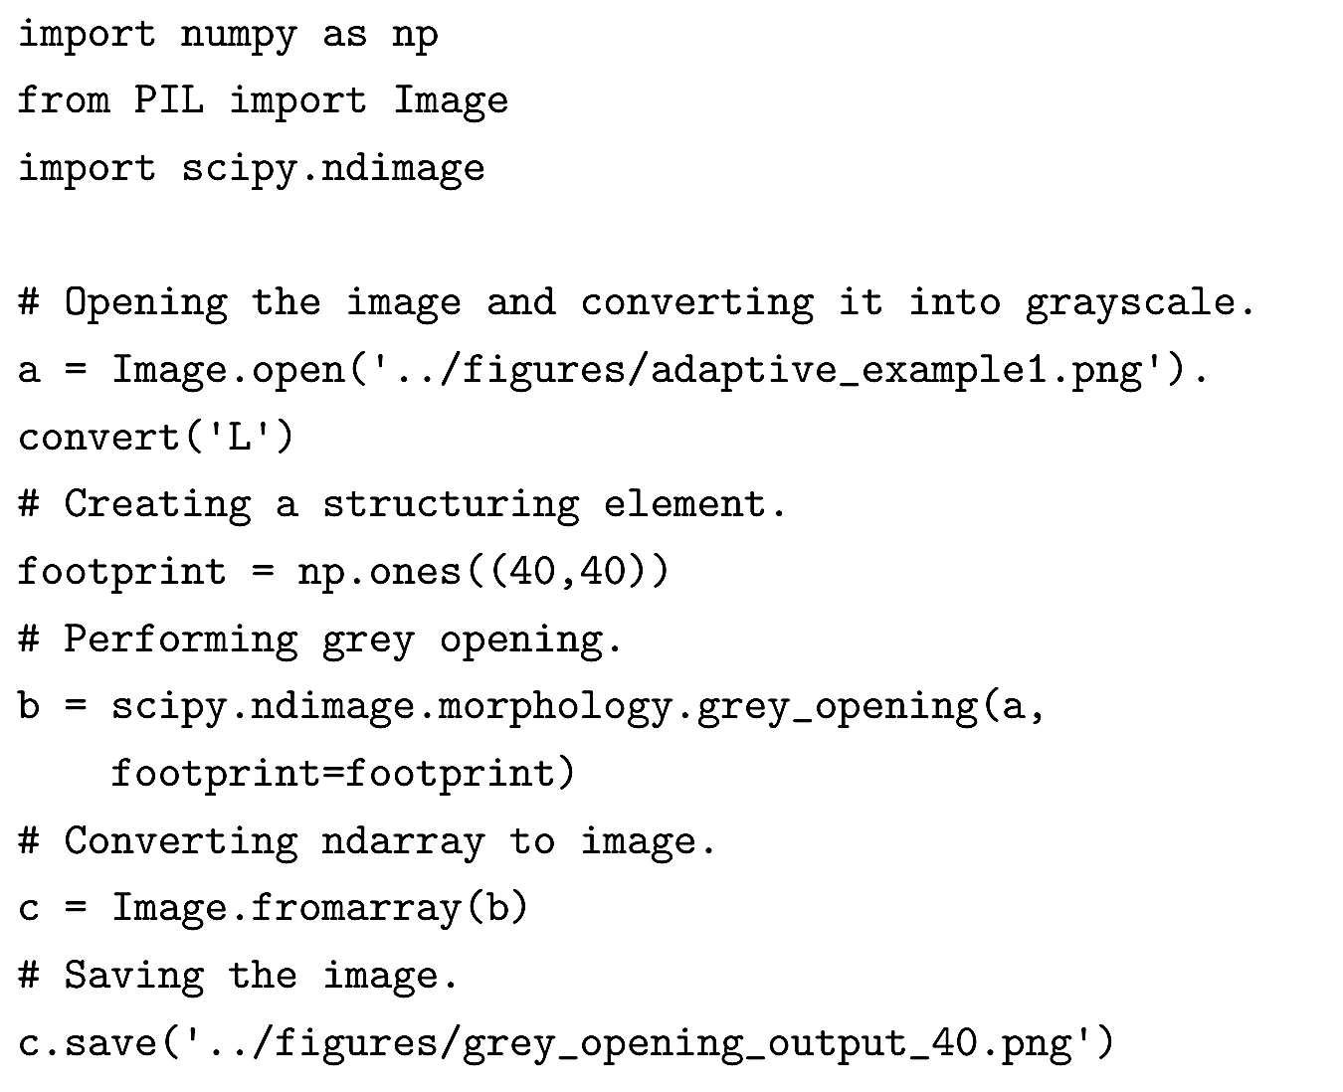
Grayscale Opening

Slide 23
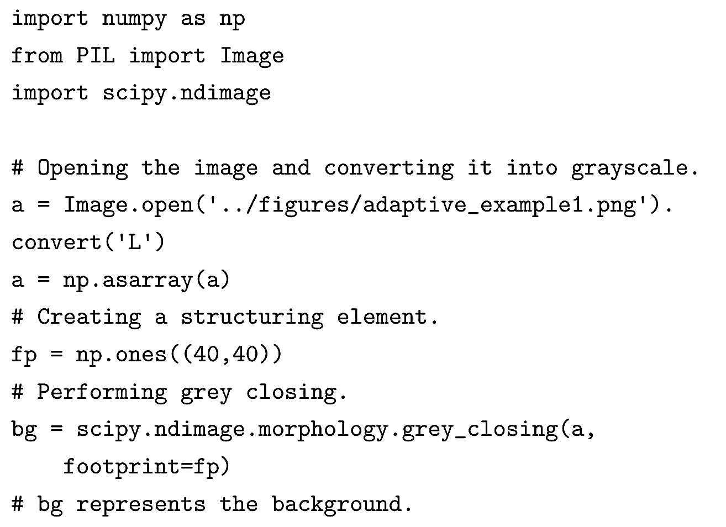
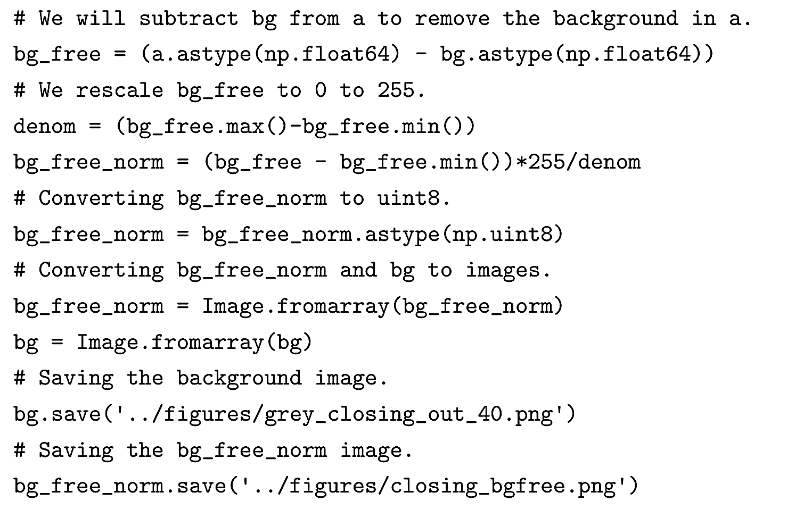
Grayscale Closing

Slide 24
Hit-or-Miss
Hit-or-miss transformation is a morphological operation used in finding specific patterns in an image.
Hit-or-miss is used to find boundary or corner pixels, and is also used for thinning and thickening.
Unlike the methods we have discussed so far, this method uses more than one structuring element and all its variations to determine pixels that satisfy a specific pattern.

Slide 25
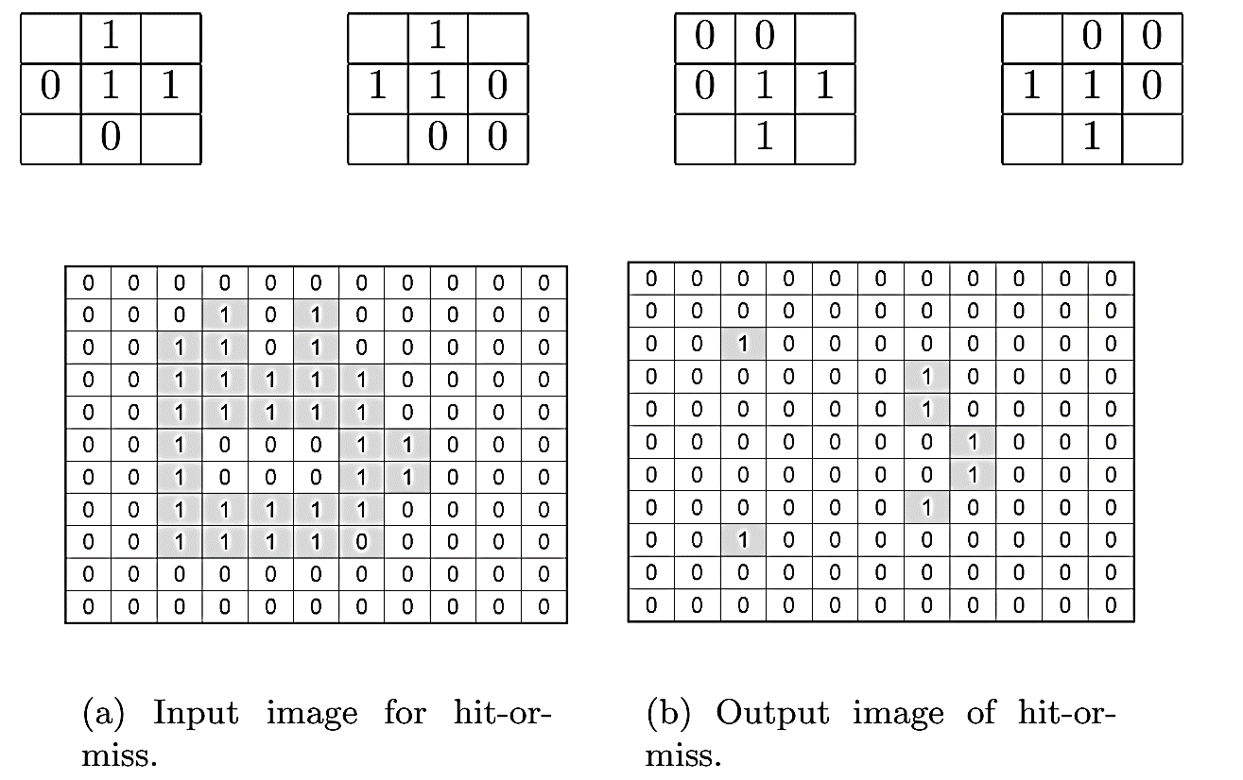
Hit-or-Miss (cont.)

Slide 26
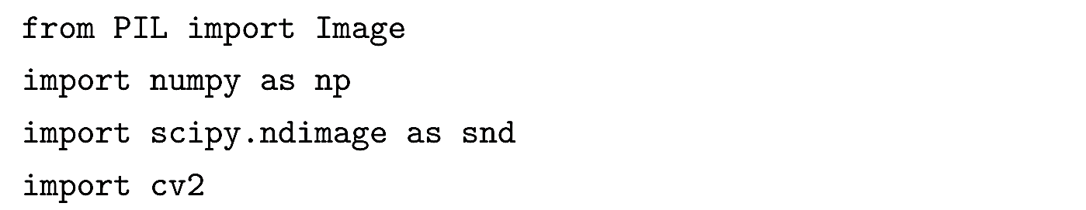
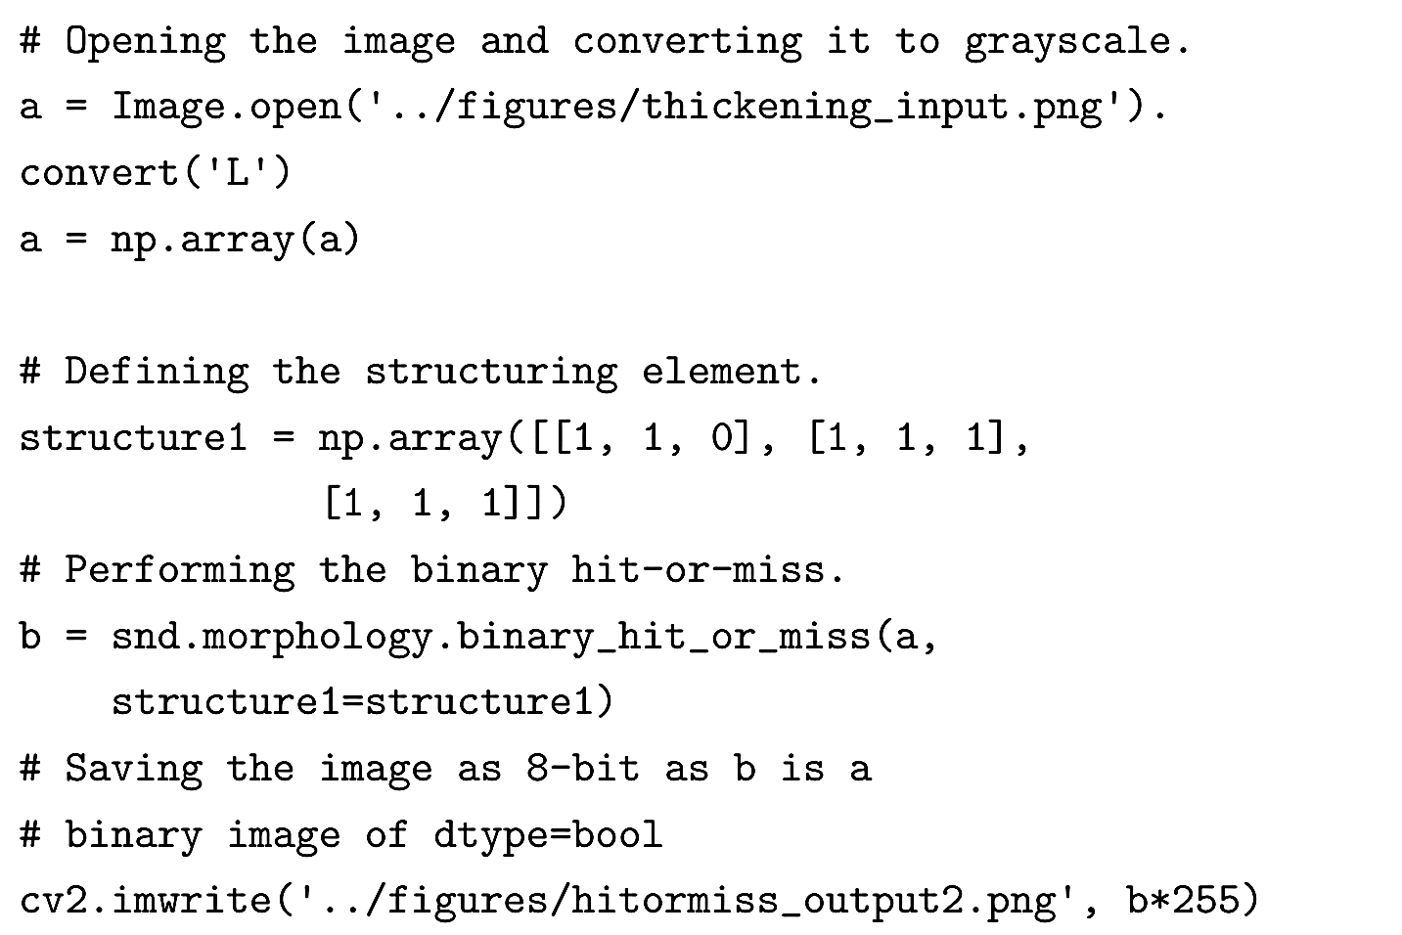
Hit-or-Miss (cont.)

Slide 27
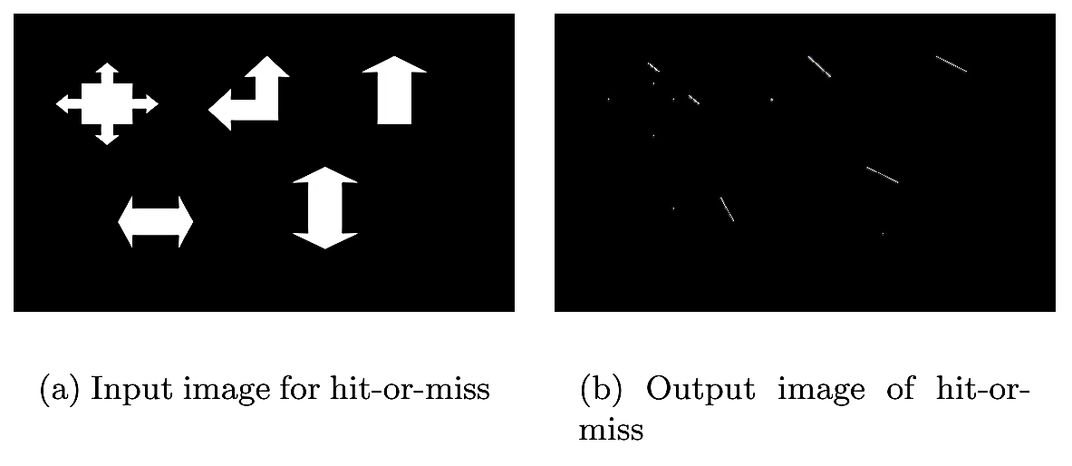
Hit-or-Miss (cont.)

